Slide 1
NEW JERSEY INSTITUTE OF TECHNOLOGY (NJIT)
COURSE: YWCC 307
Teamwork & Communication Fall 2023
SECTION 103 TUE 07:30 PM
Group 8 : JENISH PATEL & EASTER GBORTOE
Team Project - Project 3
TOPIC : AI (Artificial Intelligence) Amang Hospitality
DATE: December 5, 2023

Slide 2
Table of Contents
Self Introduction
Background of Marriott International
Considerations, Potential AI Solution
Brand-Specific Implementation, Personalization Experience
Productive Maintenance
Smart Room Management
Automated House Management or Keeping Marketing
How AI change Inventory Management
Energy Management & Revenue Management
Why AI (Artificial Intelligence )
How Marriott makes money
Key Issues facing Marriott & Ethical implication of AI
Opportunities amidst challenges
Robotic process automation In Hotel operation
Conclusion

Slide 3
Introduction
Marriott International is facing pressure to innovate and review the AI strategy for its hotel brands. Marriott is the second largest hospitality player in terms of market share in Singapore. The uptake of artificial intelligence (AI) among hospitality players in Singapore and growing consumer trust towards AI engagements over the past few years has created an impetus for Marriott to review its strategies.
Government support as well as successful use cases of front-facing AI solutions such as chatbots (i.e., digital concierges), service robots and automatic check- in/out systems, creates a favorable environment for Marriott to evaluate its next steps.
Should Marriott deploy guest-facing AI in Singapore? If so, which AI solutions, and for which hotel brand, should be implemented?

Slide 4
Our Answer is Yes
Yes, Marriott could implement the use of guest-facing AI in Singapore to improve customer satisfaction and remain on top.
Using front line AI solutions, the Marriott international brands, such as the Aloft Hotels, the Moxy Hotels and the Marriott Hotels & resorts in Singapore’s market will improve hotel guest experiences, reduce wait times, enhance and maximize security.

Slide 5
Background of Marriott International
Largest hotel chain globally.
Found in 1993 after the split of Marriott Corporation.
Business model is Hotel and Hospitality (Franchise and properties management).
Data Breach
As of 2018 serious threat by hackers. In 2023 Informal customer, and investors about their data were compromised by Hacker.
Chat bots
Offer 24/7 customer support through the help of AI.
Advantage: Reduce cost, time, and generate profits.
Disadvantage no direct human interaction.
Competition
Leading edge of business innovation and AI Technology.
Global Hotel business industry over 530 billion dollars including brands like Hilton Intercontinental, Hyatt, Wyndham and of course Marriott.

Slide 6
Considerations
Market Trends:
Given the increasing utilization of AI in the hospitality industry as well as growing consumer confidence, Marriott ought to adopt this as market trend.
Government Support:
The attitude of the government indicates that Marriott is likely to get support as well as probable incentives towards the application of AI.
Competitive Landscape:
Marriott is the second biggest player in the market and that it should employ new technology to keep on being competent amidst its competitors.
Successful Use Cases:
Analyzing successful case studies of AI solutions such as Chatbots, Service robotics, and Automatically managed check-ins/outs can indicate how Marriott should choose appropriate and established technologies.

Slide 7
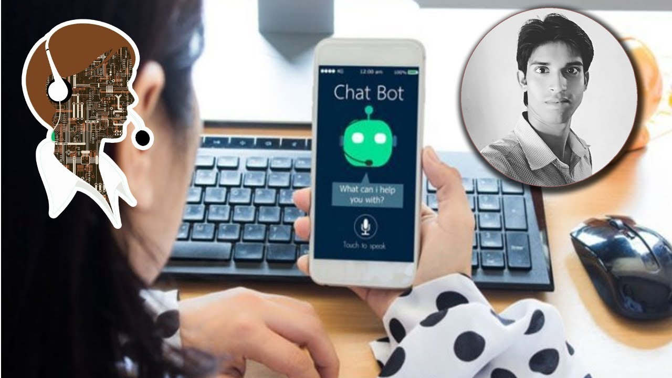
Potential AI Solutions:
Chatbots (Digital Concierges):
The deployment of AI-driven chatbots at every hotel brand would increase the quality of customer service, respond promptly to questions, and make personal suggestions.
For example, marriott could use a chatbot that understands various languages for multilingual guests.
Service Robots:
Service robots could be introduced for purposes like delivering room services, moving luggage, giving details on services in the hotel, all of which would give the experience to guests with other benefit. The robots are easily tailored according to the unique brand’s tone and atmosphere.
Human communicating with Chat Bot

Slide 8
AI Solutions Continued:
Automatic Check-in/Out Systems:
AI-enabled systems can help in streamlining the check-in and check-out of guests and consequently minimize waiting duration leading to enhanced customer experience. Facial recognition or integrating with an existing mobile app for easy access to enhance customer experience.
Personalized Recommendations:
Using AI algorithms to track down guest preferences and habits will help Marriott offer customized suggestions regarding the same services, amenities and more. This could make a more personalized and better experience for guests.
Language Translation Services:
Language can be a barrier to communication in a diverse and multicultural destination like Singapore to foreign guests. Therefore using AI-powered language translation as part of e-Government services will ease this challenge and make the interaction more comfortable for international guests to interact with locals.

Slide 9
Brand-Specific Implementation:
With reference to each of Marriott's hotel brands, consider adopting these AI solutions. For example:
Luxury Brands:
Have a strong focus on personalized touch points and integrate AI as softly and stealthily as possible in order to further refine and elevate the luxury experience.
Business Hotels:
Automatic check in/outs should be highlighted for such facilities while AI driven services for business purposes.
Boutique Hotels:
Use AI to provide a distinctive and personalized experience that is consistent with the boutique concept, including customized suggestions and thematic service robots. Before implementation, a comprehensive market research, pilot programs and feedback collection should be first undertaken to make sure that selected AI technology matches customer expectations. This entails regular updates and improvement upon customer’s suggestion and emerging AI technology at all times.

Slide 10
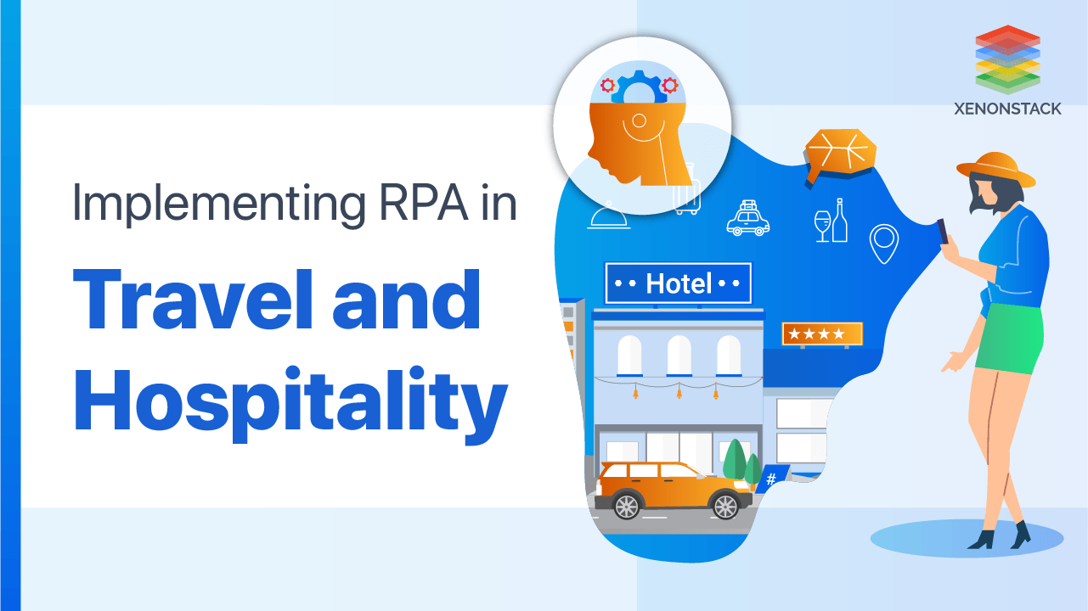
Robotic Process Automation in Hotel operations
Unlocking efficiency with RPA (Robotic Process Automation).
Cost-saving potential of RPA.
RPA’s Role in improving customer Experience.
The role of RPA in Data management and Analysis.
Integrating RPA – Challenges and Potential Solutions.

Slide 11
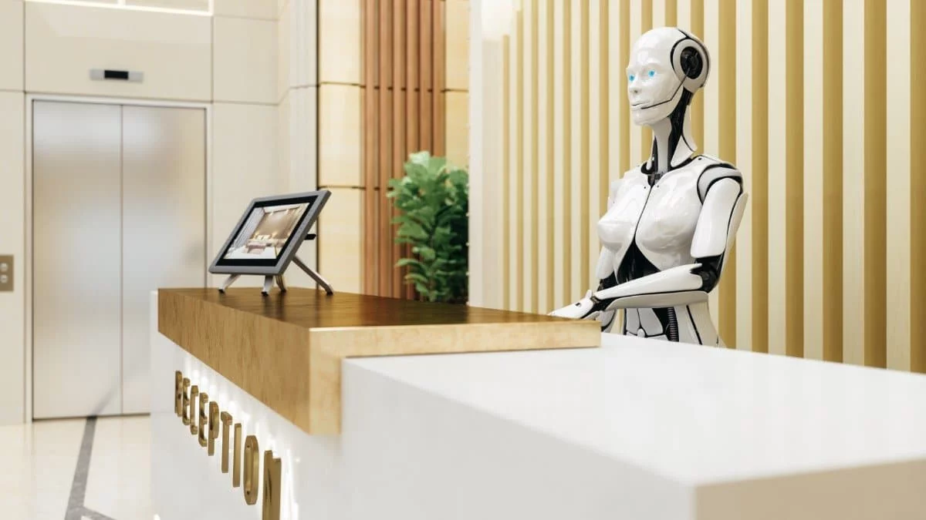
Personalization experience
Unearthing the potential of AI in personalization with the muscle power of artificial intelligence is far more potent than traditional methods and system can help identify nature language, also help make reservation.
AI-powered personalization transcends of the basic amenities.
Facial recognition automatically adjusts room setting and helps save energy and resources.

Slide 12
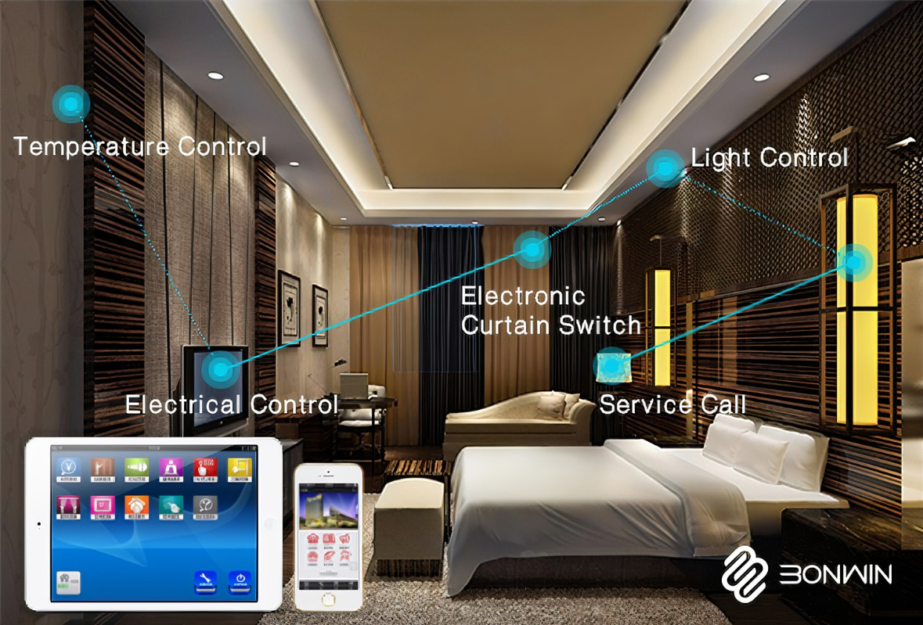
Smart Room Management
Equip with sensors that automatically adjust room setting.
Also use to protect guest safety.
These rooms, equipped with AI, allow guests to personalize their choice of what content they want on their in-room TV.
With time, these smart rooms learn and recall gust preferences, creating a customized and comfortable stay for each guest.

Slide 13
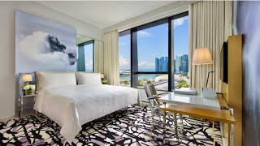
Productive Maintenance
AI system analyze data, temperature, humidity use assumption to predict equipment if failing to avoid constant break down.

Slide 14

Automated house Management or House Keeping & Marketing
Automated house management or House keeping
This program is used to clean and improve the guest experience.
MARKETING
Analyzes guest data and pricing.
Security and security surveillance will power surveillance cameras used to detect any suspicious activities or threats.

Slide 15
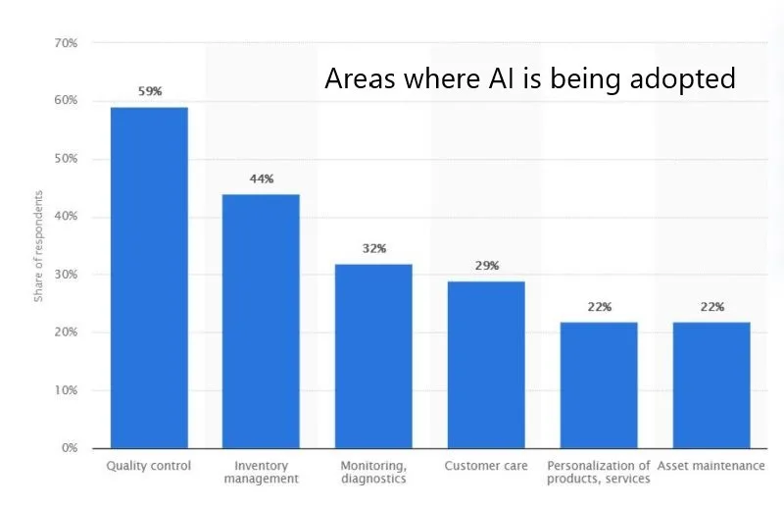
How AI Change Inventory Management
Hotels are now using advanced technology to keep track of their inventory level, including supplies. This technology automatically records the supply that is fulfilled between levels.
Making sure that the hotel has necessary supply on hand. Not only reducing cost but also helps improve guest experience. Helps predict future needs and patterns for the best customer experience.
Foods and beverages is one of the area that AI is making an impact on. An example is that an apple can be used to analyze data on different kinds of foods. With the automated system it helps keep track of the quality of foods and provides this improvement for guest experience.

Slide 16
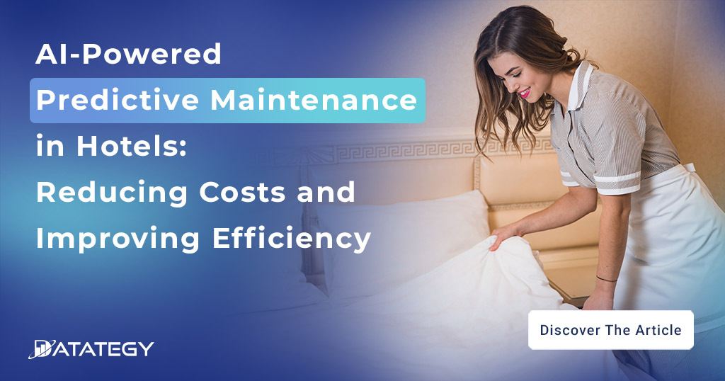
Energy Management
Advance energy management can optimize energy consumption in hotel.
This technology can monitor and adjust lighting, heating, and cooling systems.
To reduce energy consumption and costs. It can analyze data on energy consumption to identify the data which can be used to make decisions.

Slide 17
Revenue Management
AI technology is used to analyze hotel occupancy, pricing and increase in revenue. Using this technology helps predict historic data pricing accordingly maximizing profitability.
Also help to track different marketing and competitors. This technology can be integrated into other technologies such as chatbots and virtual reality to optimize customer experience.

Slide 18
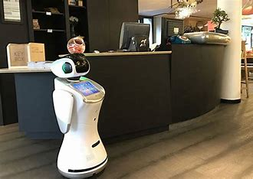
Why AI (Artificial Intelligence)
Greater impact on the hospitality for customers. As we are living in a dynamic society.
Operation efficiency and improve guest experience.
To have Competitive advantage.
Reduce labor cost, time, and money.
Generate profits & bring in innovation.
Track customer behaviors.
Help business do proper planning.
Predict the future.

Slide 19
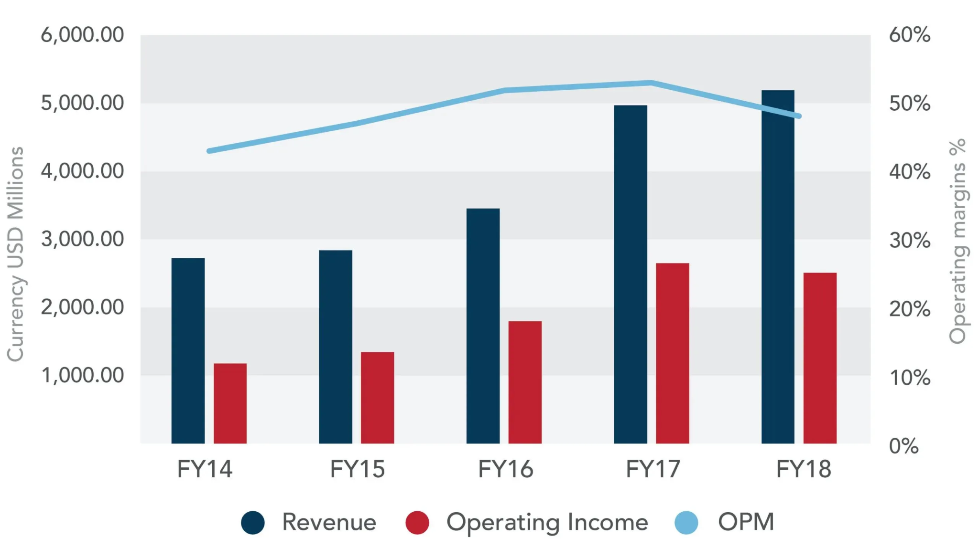
How Marriott makes money
Graphical Outlook through AI Over five (5) years.
Its full-service hotels offering more restaurants and other amenities.
Asset business Management or franchise hotels & partner with other businesses such as credit card companies like American Express (AMEX).
In 2021 there were two new programs introduced which are contactless check-in/out and contactless food and drink vending machines.

Slide 20
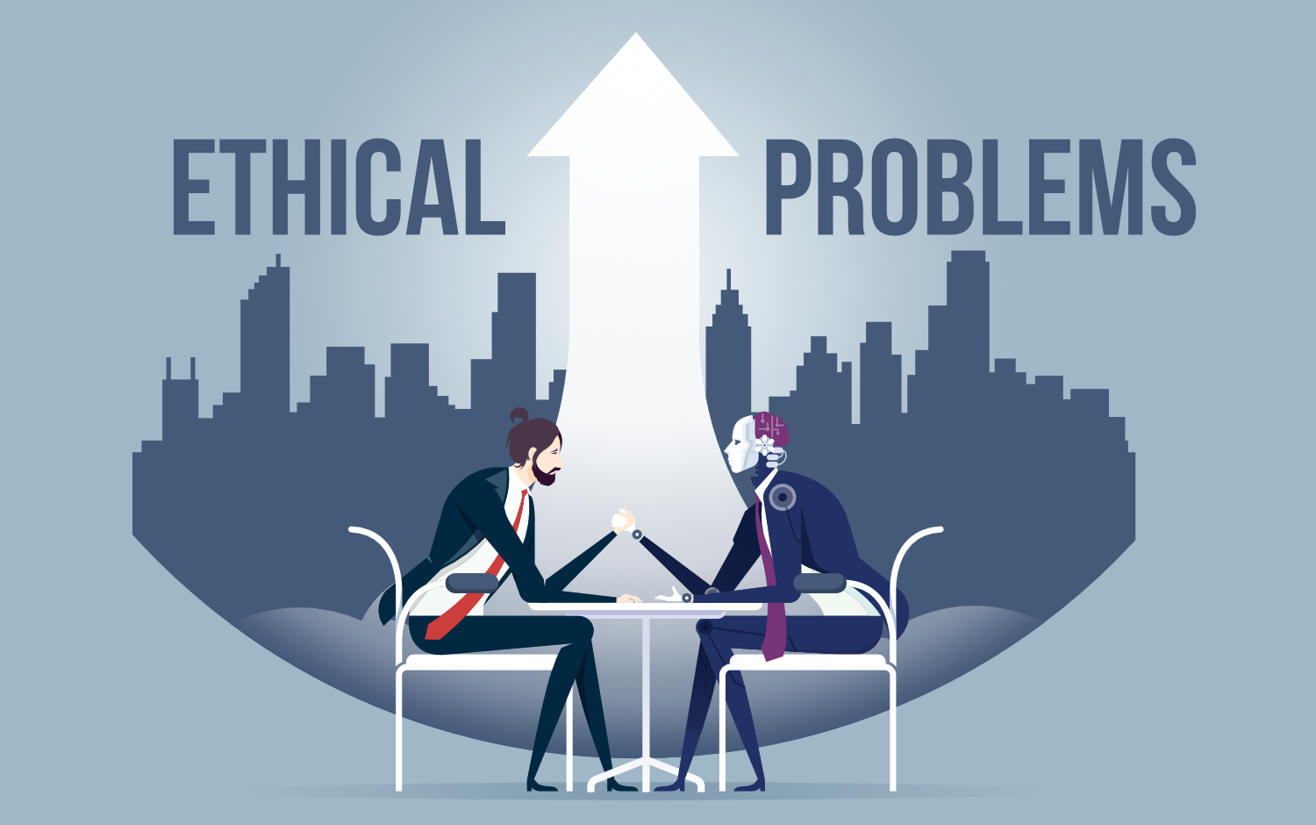
Ethical Implications of AI
Privacy concerns is the ethical dimension of AI in the hospitality industry.
Ethical Concerns:
Human interaction and trust.
Confidentiality and Integrity among users.
A proactive approach to these concerns can differentiate a company in the crowded marketplace, demonstrating a genuine commitment to AI usage.

Slide 21
Key issues Marriott facing with AI
The privacy paradox needs to build robust and secure system that can provide customized services without infringing on customer privacy.
Transparent Data Practices stating their intentions and practices in relation to data collection, storage, usage, and sharing.

Slide 22
Conclusion
In conclusion, Marriott International has no better time than now to use guest facing-AI for Marriott International Singapore as the industry trends, the government will provide all the necessary support while other companies already implementing the technology for various aspects. In this respect, customizing AI solutions for different hotel brands like Chatbots, Service Robots and Automatic check in/out system can increase guest experience and stay competitive. The adoption of AI is direct correlation with consumers’ desires for technologically advancement that leads to a smooth, timely, and individualized stay. Sustained effectiveness of the integration of AI across the Marriott’s diverse portfolios in Singapore will require providing regular feedback and continuous improvement.

Slide 23
Bibliography
AI in Hospitality ( Innovative Solutions for Travel and Tourism) by Goeffrey Ingram on sale on Amazon.
Marriott International: Deploying AI across Hotel Brands in Singapore by Hannah H. Chang, Emerlyn Ng, Joyce Chua, Matthew Blower, Sarah de Souza, Tiffany Gwee 31 Aug 2022
HOW HOTEL BRANDS UTILIZE AI TO THEIR ADVANTAGE March 30, 2023 Hotel Technology, Innovations & Disruptions
How AI is Transforming Hotels By Presley DevAnnand
Artificial Intelligence ( Applications in the future of software engineering) by: D. Partridge, Ph.D., B.S Computing Research Laboratory, New Mexico State University

Slide 24
Q /A

